Slide 1
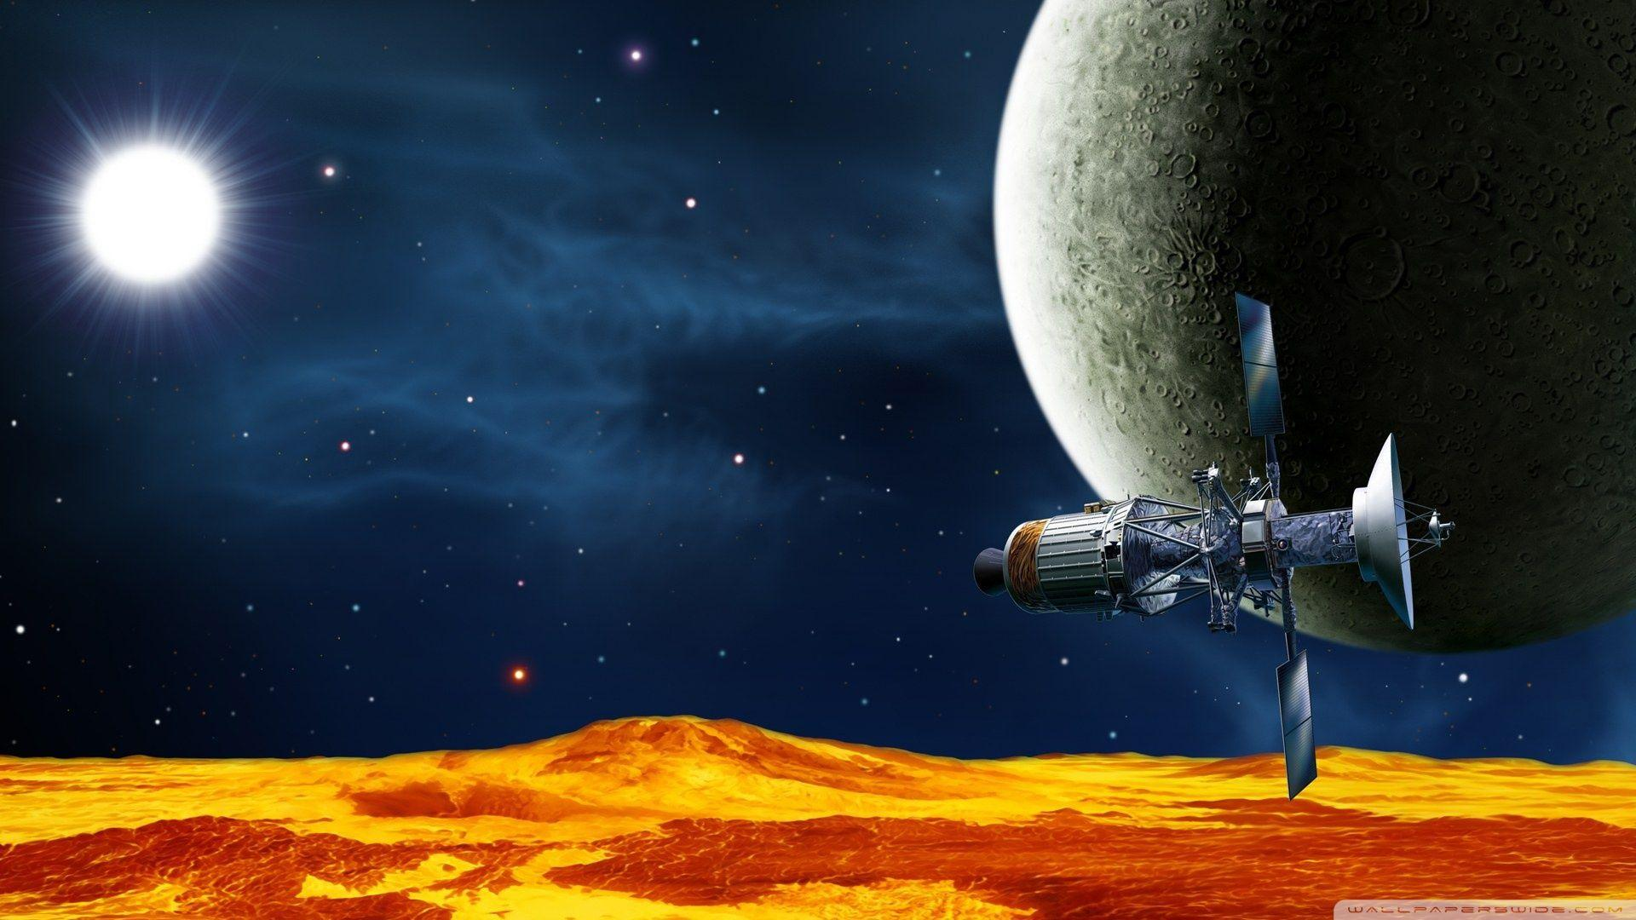

SpaceX
With Data Science
Subrat Nanda
11/05/2023

Slide 2
Outline
Executive Summary
Introduction
Methodology
Insights Drawn From E.D.A
Launch Sites Proximities
Dashboard With Ploty Dash
Predictive Analytics
Results
Conclusion
Appendix

Slide 3
Executive Summary
Problem Statement :
According to CB Insights statistics, 20% of startups fail because they got outcompeted while 8% of startups were sunk because of poor products. Our competitor SpaceX, dominates the market because of the reusability of its rockets. To outcompete them, it is imperative to determine our product performance. In this case, we need a way to predict the landing outcome of our rockets after they are launched.
Solution :
We collected data on SpaceX’s Falcon 9 rocket launches and used it to train Machine Learning models that predict whether the rocket’s first stage will land successfully. This was done in the following ways:
Data Collection through API
Data Collection with Web Scraping
Data Wrangling
Exploratory Data Analysis with SQL
Exploratory Data Analysis with Data Visualization
Interactive Visual Analytics with Folium
Machine Learning Prediction
* Note : that the data collection stage was carried out using API requests and Web Scraping in order to minimize costs.

Slide 4
Cont..
Value :
The predictive models enabled the company to determine the success of a rocket landing. This was especially important because a failed landing could result in a loss of tens of millions of dollars. Furthermore, it enabled the company to determine costs and make more attractive offers than SpaceX.
Final Thoughts and Next Steps :
Powerful Analytics and Machine Learning tools not only increase our competitiveness – but they can also increase customer confidence in our offerings. With the attention of these offerings, we expect to break into a market projected to reach USD 26.16 billion by 2027.
For more information, find the full project repository:
https://github.com/Subrat-Nanda/IBM-Data-Science-Professional-Certification/Project

Slide 5
Introduction
SpaceX is a revolutionary company that has disrupted the space industry by offering rocket launches specifically Falcon 9 as low as 62 million dollars; while other providers cost upward of 165 million dollars each. Most of these savings is thanks to SpaceX’s astounding idea to reuse the first stage of the launch by re-land the rocket to be used on the next mission. Repeating this process will make the price down even further. As a data scientist of a startup rivaling SpaceX, the goal of this project is to create a machine learning pipeline to predict the landing outcome of the first stage in the future. This project is crucial in identifying the right price to bid against SpaceX for a rocket launch.
The problems included:
Identifying all factors that influence the landing outcome.
The relationship between each variable and how it is affecting the outcome.
The best condition needed to increase the probability of a successful landing.

Slide 6


5

Slide 7
Methodology
Executive Summary
Steps :
Collect data using SpaceX REST API and web scraping techniques.
Sources :
Space X API (https://api.spacexdata.com/v4/rockets/)
WebScraping (https://en.wikipedia.org/wiki/List_of_Falcon/_9/_and_Falcon_Heavy_launches)
Wrangle data – by filtering the data, handling missing values, and applying one hot encoding – to prepare the data for analysis and modeling
Explore data via EDA with SQL and data visualization techniques
Visualize the data using Folium and Plotly Dash
Build Models to predict landing outcomes using classification models. Tune and evaluate models to find the best model and parameters

Slide 8






Data Collection – SpaceX API
7
Steps :
Request data from SpaceX API (rocket launch data)
Decode response using .json() and convert to a data frame using .json_normalize()
Request information about the launches from SpaceX API using custom functions
Create a dictionary from the data
Create a dataframe from the dictionary
Filter dataframe to contain only Falcon 9 launches
Replace missing values of Payload Mass with calculated .mean()
Export data to CSV file
Make request to SpaceX API
Decode the response content as a Json
Turn Json into pandas data frame
Use the API again to get information about the launches using the IDs given for each launch
Filter the dataframe to only
include Falcon 9 launches
Construct our dataset using
the data we have obtained
Replace null values in the data with the mean that was calculated
Convert data frame into a CSV dataset
URL: https://github.com/Subrat-Nanda/spacex-data-collection-api.ipynb

Slide 9




Data Collection - Web Scraping
Steps :
Request data (Falcon 9 launch data) from Wikipedia
Create BeautifulSoup object from HTML response
Extract column names from the HTML table header
Collect data from parsing HTML tables
Create a dictionary from the data
Create a dataframe from the dictionary
Export data to CSV file
Request the Falcon9 Launch Wiki page from its URL
Create
a BeautifulSoup object from the HTML respone
Create an empty dictionary with keys from the extracted column names
Extract all column/variable names from the HTML table header
Fill up
the dictionary with launch records extracted from table rows.
Convert the dictionary into a CSV dataset
URL : https://github.com/Subrat-Nanda/Webscraping.ipynb

Slide 10

Data Wrangling
Steps.
Landing Outcome Cont ..
False Ocean: represented an unsuccessful landing to a specific region of the ocean.
True RTLS: meant the mission had a successful landing on a ground pad.
False RTLS: represented an unsuccessful landing on a ground pad.
True ASDS: meant the mission outcome had a successful landing on a drone ship.
False ASDS: represented an unsuccessful landing on the drone ship.
Outcomes converted into -
1 - successful landing
0 - unsuccessful landing.
Perform EDA and determine data labels
Calculate:
# of launches for each site
# and occurrence of orbit
# and occurrence of mission
outcome per orbit type]
Create a binary landing outcome
column (dependent variable)
Export data to CSV file
Determine the number of launches on each facility
Calculate the number and occurrences of each orbit
Calculate the number and occurences of mission outcome per orbit type
Create a landing outcome training label and loop through all the landing outcomes
Landing Outcome
Create a "Class" column containing the information from the outcome label
Landing was not always successful
True Ocean: mission outcome had a successful landing to a specific region of the ocean
Transform the data frame into a CSV dataset.
URL: https://github.com/Subrat-Nanda/Data_wrangling.ipynb

Slide 11
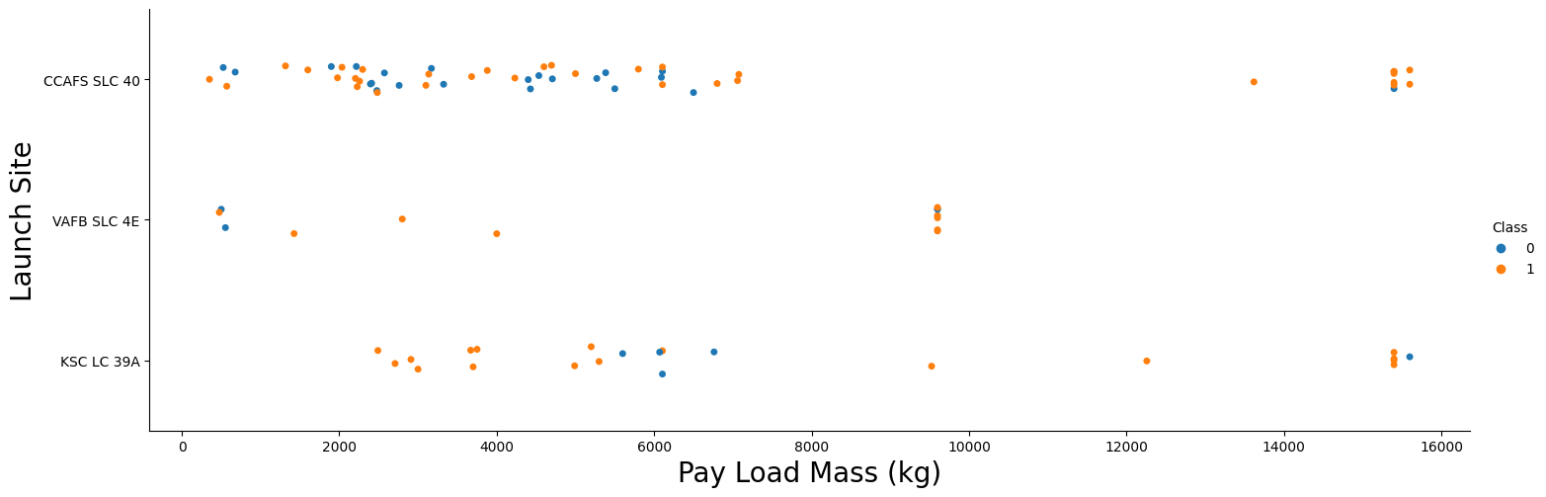
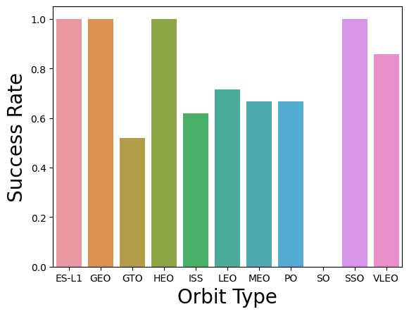
EDA with Data Visualization
Charts
• Flight Number vs. Payload
• Flight Number vs. Launch Site
• Payload Mass (kg) vs. Launch Site
• Payload Mass (kg) vs. Orbit type
Analysis
• View the relationship by using scatter plots. The variables could be useful for machine learning if a relationship exists
• Show comparisons among discrete categories with bar charts. Bar charts show the relationships among the categories and a measured value
URL :
https://github.com/Subrat-Nanda/EDA_dataviz.ipynb

Slide 12
EDA with SQL
The following SQL queries were performed:
• Names of the unique launch sites in the space mission;
• Top 5 launch sites whose name begins with the string 'CCA’;
• Total payload mass carried by boosters launched by NASA (CRS);
• Average payload mass carried by booster version F9 v1.1;
• Date when the first successful landing outcome in the ground pad was achieved;
• Names of the boosters which have success in drone ships and have payload mass between 4000 and 6000 kg;
• Total number of successful and failed mission outcomes;
• Names of the booster versions which have carried the maximum payload mass;
• Failed landing outcomes in drone ships, their booster versions, and launch site names for the year 2015; and
• Rank of the count of landing outcomes (such as Failure (drone ship) or Success (ground pad)) between the dates 2010-06-04 and 2017-03-20.
• Source code: https://github.com/Subrat-Nanda/EDA_SQL.ipynb

Slide 13
Build an Interactive Map with Folium
Markers Indicating Launch Sites
Added a Blue circle at NASA Johnson Space Center's coordinate with a popup label showing its name using its latitude and longitude coordinates.
Added Red circles at all launch site coordinates with a popup label showing its name using its latitude and longitude coordinates
Colored Markers of Launch Outcomes
Added colored markers of successful (Green) and unsuccessful (Red) launches at each launch site to show which launch sites have high success rates
Distances Between a Launch Site to Proximities
Added colored lines to show the distance between launch site CCAFS SLC 40 and its proximity to the nearest coastline, railway, highway, and city.

Slide 14
Dashboard with Plotly Dash
Launch Sites Dropdown List:
Added a dropdown list to enable Launch Site selection.
Pie Chart showing Success Launches (All Sites/Certain Sites):
- Added a pie chart to show the total successful launches count for all sites and the
Success vs. Failed counts for the site, if a specific Launch Site was selected.
A slider of Payload Mass Range:
Added a slider to select the Payload range.
Scatter Chart of Payload Mass vs. Success Rate for the different Booster Versions:
Added a scatter chart to show the correlation between Payload and Launch Success.
Source Code : SpaceX_Dashboard_with_Plotly_Dash

Slide 15

Predictive Analytics (Classification)
Charts
• Create a NumPy array from the Class column
• Standardize the data with StandardScaler.Fit & transform the data.
• Split the data using train_test_split
• Create a GridSearchCV object with cv=10 for parameter optimization
• Apply GridSearchCV on different algorithms:
logistic regression (LogisticRegression())
support vector machine (SVC())
decision tree (DecisionTreeClassifier())
K-Nearest Neighbor (KNeighborsClassifier())
• Calculate accuracy on the test data using .score() for all models
• Assess the confusion matrix for all models
• Identify the best model using Jaccard_Score, F1_Score & Accuracy
Create a column for the class
Split data into training data and test data
Standardize the data
Calculate the accuracy on the test data
Create a GridSearchCV object and fit different ML objects.
Choose the best ML method
Compare the predictions with the real labels

Slide 16
Results Summary
Exploratory Data Analysis :
• Launch success has improved over time
• KSC LC-39A has the highest success rate among landing sites
• Orbits ES-L1, GEO, HEO, and SSO have a 100% success rate
Visual Analytics :
• Most launch sites are near the equator, and all are close to the coast
• Launch sites are far enough away from anything a failed launch can damage (city, highway, railway), while still close enough to bring people and material to support launch activities
Predictive Analytics :
• Decision Tree model is the best predictive model for the dataset

Slide 17


Slide 18
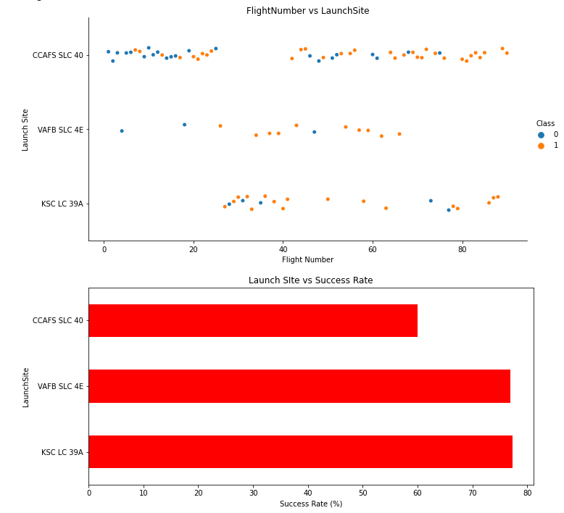
Flight Number vs. Launch Site
Exploratory Data Analysis
• Earlier flights had a lower success rate (blue = fail).
• Later flights had a higher success rate (orange = success).
• Around half of the launches were from CCAFS SLC 40 launch site.
• VAFB SLC 4E and KSC LC 39A have higher success rates.
• We can infer that new launches have a higher success rate.

Slide 19
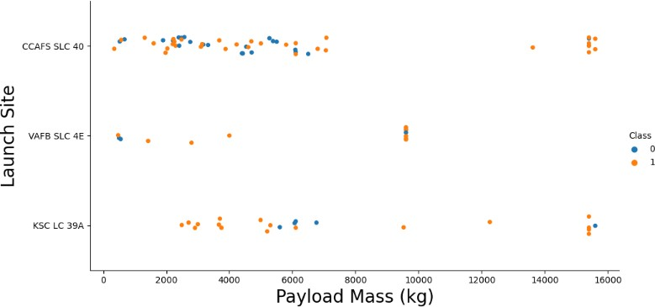
Payload vs. Launch Site
Exploratory Data Analysis
Typically, the higher the payload mass (kg), the higher the success rate.
Most launches with a payload greater than 7,000 kg were successful
KSC LC 39A has a 100% success rate for launches less than 5,500 kg
VAFB SKC 4E has not launched anything greater than ~10,000 kg

Slide 20
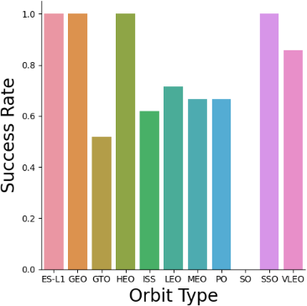
Success Rate vs. Orbit Type
The biggest success rates happen to orbits:
• ES-L1;
• GEO;
• HEO; and
• SSO.
Followed by:
• VLEO (above 80%); and
• LFO (above 70%).

Slide 21
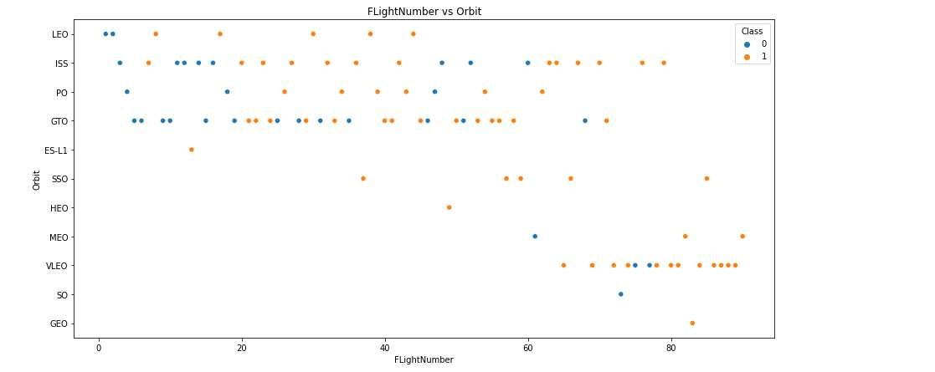
Flight Number vs. Orbit Type
You can see that in the LEO orbit the Success appears related to the number of flights; on the other hand, there seems to be no relationship between flight number when in GTO orbit.

Slide 22
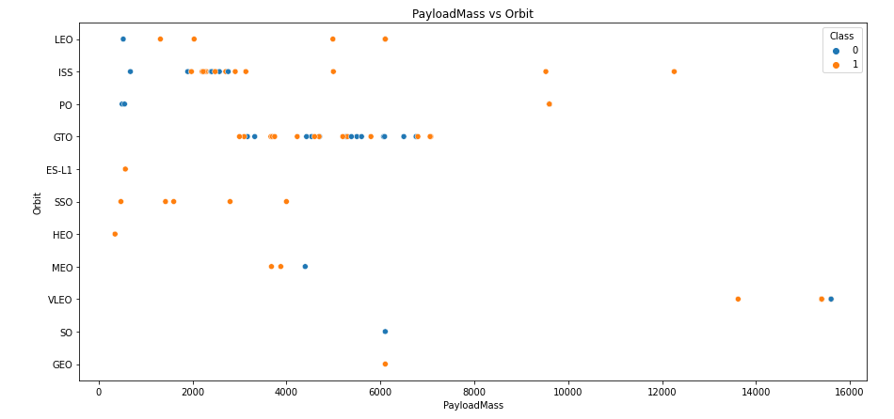
Payload vs. Orbit Type
With heavy payloads the successful landing or positive landing rate are more for Polar, LEO and ISS.
However for GTO we cannot distinguish this well as both positive landing rate and negative
landing(unsuccessful mission) are both there.

Slide 23
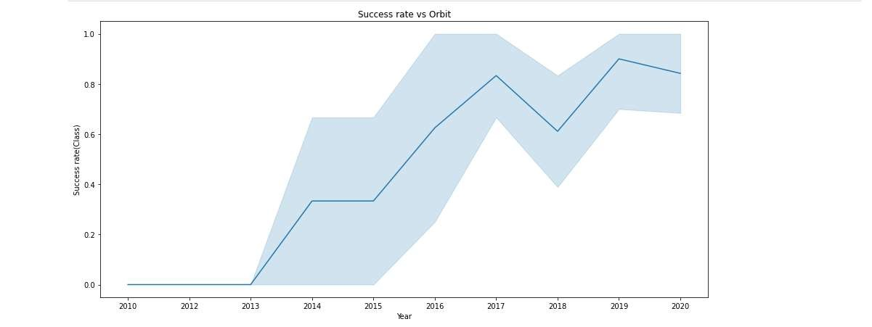
Launch Success Yearly Trend
It is apparent that the success rate has significantly increased from 2013 to 2020.

Slide 24
All Launch Site Names
Given the data, these are the names of the launch sites where different rocket landings where attempted:
CCAFS LC-40
CCAFS SLC-40
KSC LC-39A
VAFB SLC-4E

Slide 25
Launch Site Names Beginning with 'CCA'
Date | Launch_Site | Orbit | Customer | Mission_Outcome | Landing_Outcome
04-06-2010 | CCAFS LC-40 | LEO | SpaceX | Success | Failure (parachute)
08-12-2010 | CCAFS LC-40 | LEO (ISS) | NASA (COTS) NRO | Success | Failure (parachute)
22-05-2012 | CCAFS LC-40 | LEO (ISS) | NASA (COTS) | Success | No attempt
08-10-2012 | CCAFS LC-40 | LEO (ISS) | NASA (CRS) | Success | No attempt
01-03-2013 | CCAFS LC-40 | LEO (ISS) | NASA (CRS) | Success | No attempt
These are 5 records where launch sites begin with the letters 'CCA'. As we can see, there are other organizations besides SpaceX that were testing their rockets.

Slide 26
Total Payload Mass
Customer | Total_Payload_Mass
NASA (CRS) | 45596
NASA (CCDev) | 12530
NASA (CCP) | 12500
NASA (CCD) | 12055
NASA (CTS) | 12050
NASA (CRS), Kacific 1 | 2617
NASA / NOAA / ESA / EUMETSAT | 1192
NASA (LSP) NOAA CNES | 553
NASA (COTS) | 525
NASA (LSP) | 362
NASA (COTS) NRO | 0
The information in the table displays the total payload mass carried by boosters launched by NASA.
It seems that NASA (CRS) had a significantly higher total payload mass compared to the rest.

Slide 27
Average Payload Mass by F9 v1.1
Average_Payload_Mass (kg) | Booster_Version
2928.4 | F9 v1.1
The average payload mass carried by F9 v1.1 was 2928.4 kg.

Slide 28
First Successful Ground Landing Date
Date | Landing_Outcome
22-12-2015 | Success (ground pad)
The first successful ground pad landing took place in December 2015. This was a historic reusable-rocket milestone for both SpaceX and the world.
Prior to this, no one had ever brought an orbital class booster back intact.

Slide 29
Successful Drone Ship Landing with Payload between 4000 and 6000
Booster_Version | PAYLOAD_MASS KG_ | Landing_Outcome
F9 FT B1022 | 4696 | Success (drone ship)
F9 FT B1026 | 4600 | Success (drone ship)
F9 FT B1021.2 | 5300 | Success (drone ship)
F9 FT B1031.2 | 5200 | Success (drone ship)
It appears that there only 4 Boosters with a payload mass between 4000
and 6000.
It is interesting to see that they all had successful landing outcomes.

Slide 30
Total Number of Successful and Failure Mission Outcomes
Mission_Outcome | Outcomes
Failure (in flight) | 1
Success | 99
Success (payload status unclear) | 1
It appears that missions generally tend to be successful with the exception of one failure.

Slide 31
Boosters That Carried the Maximum Payload Mass
12 boosters have carried the maximum payload mass of 15600 kg.
Since the version names are similar, they might be from the same manufactures.
Booster_Version | PAYLOAD_MASS KG_
F9 B5 B1048.4 | 15600
F9 B5 B1049.4 | 15600
F9 B5 B1051.3 | 15600
F9 B5 B1056.4 | 15600
F9 B5 B1048.5 | 15600
F9 B5 B1051.4 | 15600
F9 B5 B1049.5 | 15600
F9 B5 B1060.2 | 15600
F9 B5 B1058.3 | 15600
F9 B5 B1051.6 | 15600
F9 B5 B1060.3 | 15600
F9 B5 B1049.7 | 15600

Slide 32
2015 Launch Records - Failed Landing Outcomes
Date | Launch_Site | Booster_Version | Landing_Outcome
10-01-2015 | CCAFS LC-40 | F9 v1.1 B1012 | Failure (drone ship)
14-04-2015 | CCAFS LC-40 | F9 v1.1 B1015 | Failure (drone ship)
It appears that 2 boosters failed to land at the beginning of the year..
The first successful landing took place later that year in December as we saw earlier.

Slide 33
Rank Landing Outcomes Between 2010-06-04 and 2017-03-20
If we observe the table, it is apparent that the number of successful landings have increased since 2015.
Before 2013, it seems that there were no attempts to land the boosters.
_date_ | Landing_Outcome | Outcomes
2016-04-08 | Success (drone ship) | 14
2015-12-22 | Success (ground pad) | 9
2015-06-28 | Precluded (drone ship) | 1
2015-01-10 | Failure (drone ship) | 5
2014-04-18 | Controlled (ocean) | 5
2013-09-29 | Uncontrolled (ocean) | 2
2012-05-22 | No attempt | 22

Slide 34


Slide 35
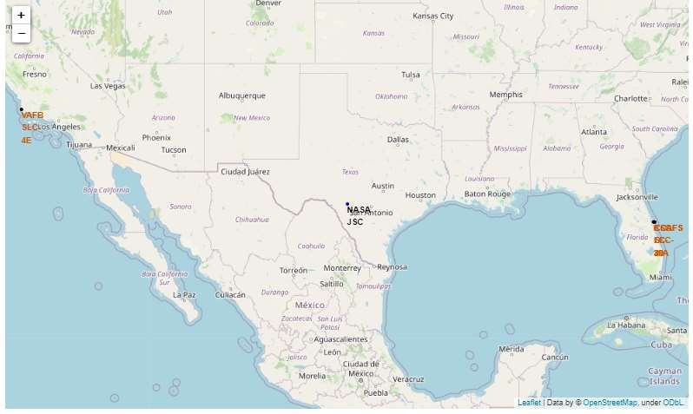
Launch Site Locations
We can see that all launch sites are in very close proximity to the coast and they are also a couple thousand kilometers away from the equator line.
It is interesting to see that most launch sites are concentrated near Miami.

Slide 36
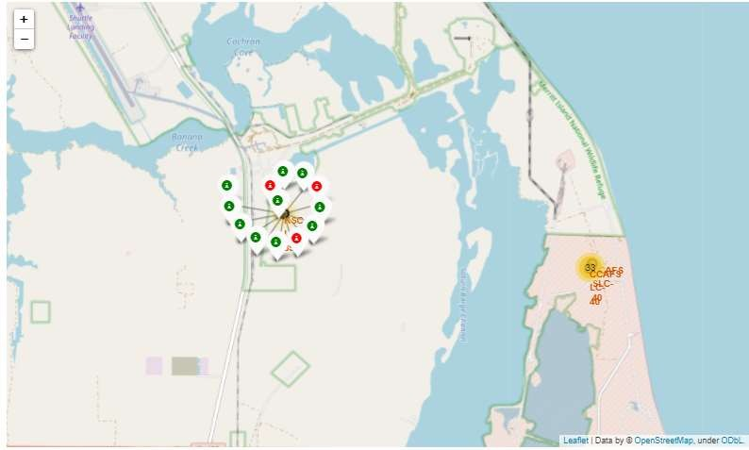
Success Rate of Rocket Launches
The successful launches are represented by a green marker while the red marker represents failed rocket launches.
It appears that KSC LC- 39A had the highest success rate of rocket launches compared to other launch sites.

Slide 37
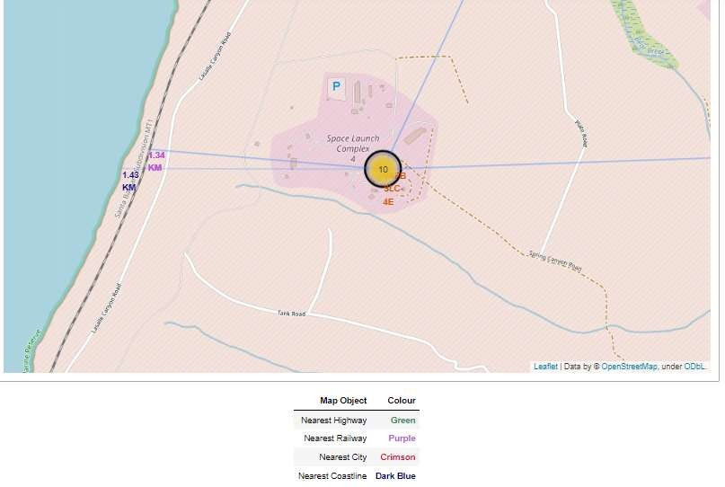
Surrounding Landmarks
It appears that launch sites are usually set up at least 18 km away from cities. This may be because of the desire to prevent any crashes near populated areas.
It is also apparent that launch sites are in very close proximity to railways and highways. Perhaps, due to the necessary transportation requirements for rocket parts.
The sites are close the coast line. This is evident with the many rocket landing tests on water bodies like the ocean.

Slide 38


Slide 39
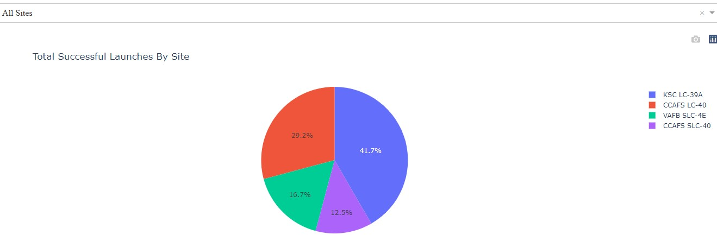
Successful Launches by Site
Site KSC LC-39A has the largest successful launches as well the highest launch success rate.
More investigation may be needed to determine why KSC LC-39A is the preferred launch site.

Slide 40
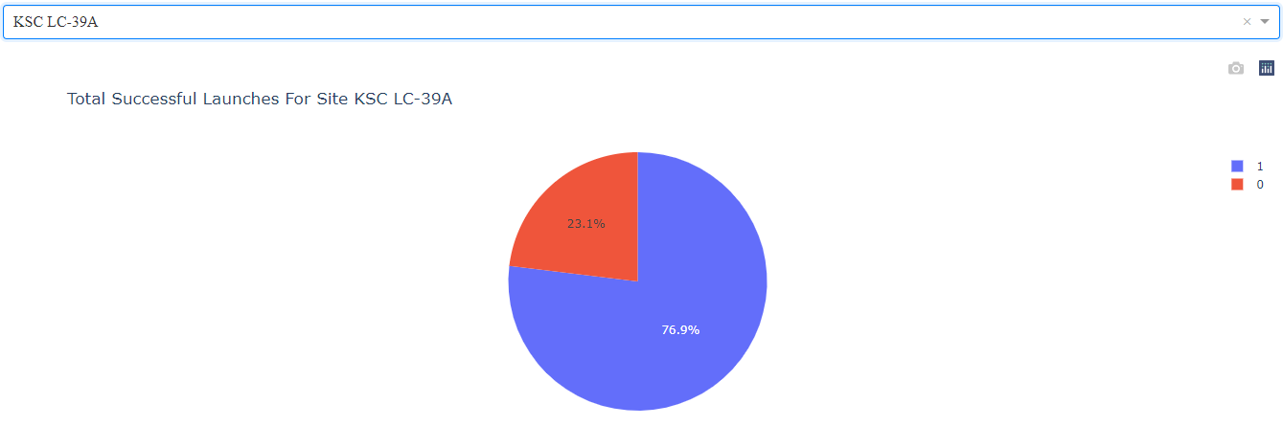






Total Successful Launches for Site KSC LC-39A
As we can see, 76.9% of the total launches at site KSC LC-39A were successful. This is a the highest success rate of all the different launch sites.
However, this success rate was only around 3% higher than the runner up; site CCAFS LC-40.

Slide 41
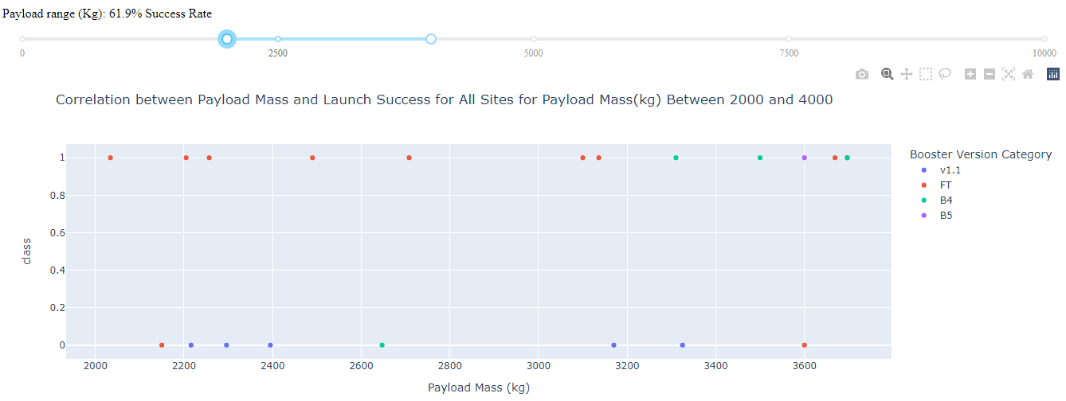
Payload Mass vs. Launch Success for All Sites
It appears that the payload range between 2000 kg and 4000 kg has the highest success rate.
The launch success rate was also dramatically low between the payload range of 0kg and 2500kg. Perhaps very low masses decrease launch success.
The booster version FT, seems to have a higher success rate than other booster versions

Slide 42
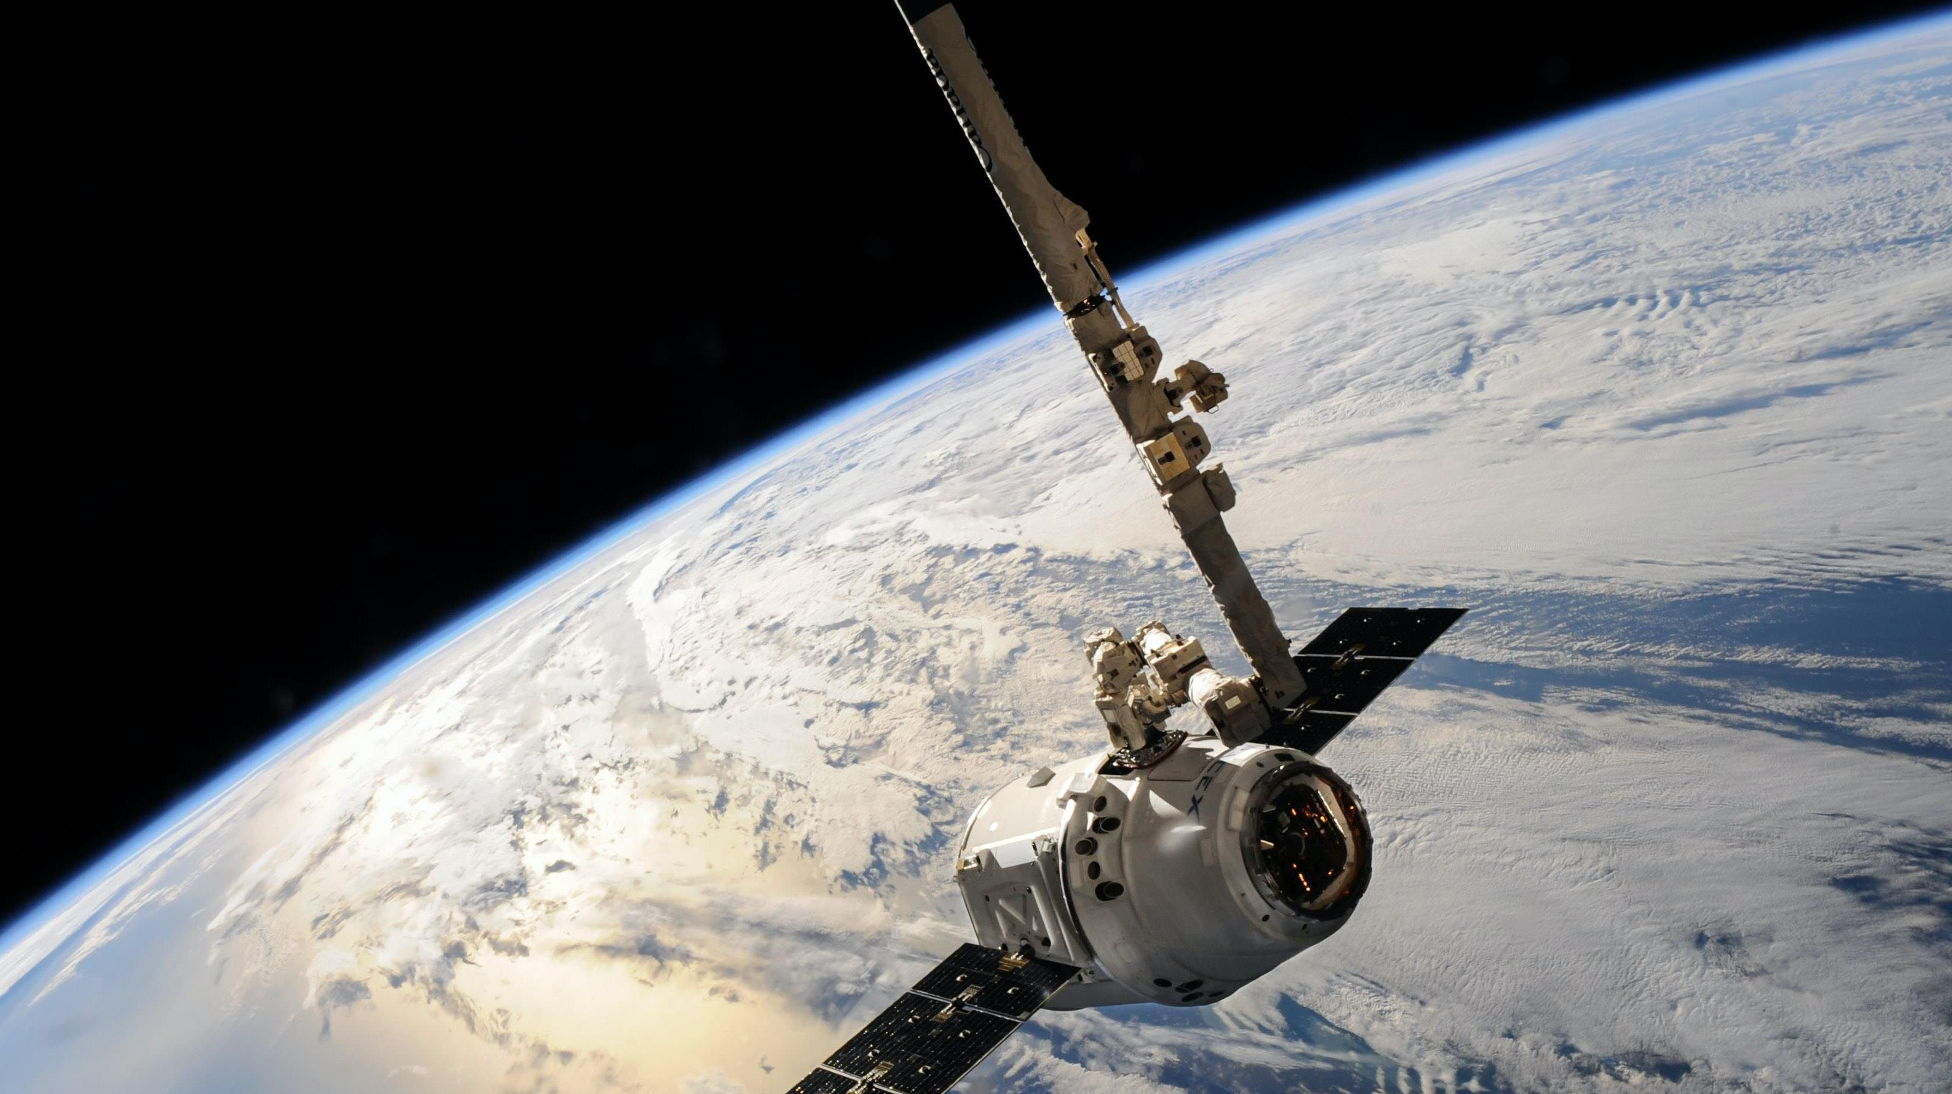
Predictive Analytics (Classification)

Slide 43
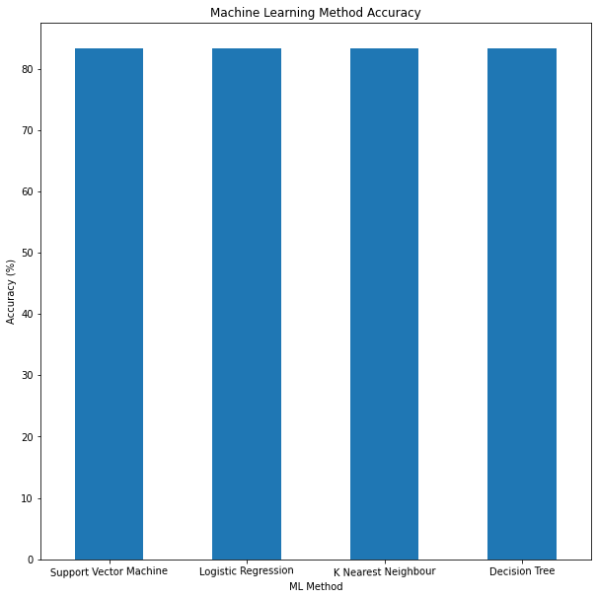

Classification Accuracy
Accuracy :
• All the models performed at about the same level and had the same scores and accuracy. This is likely due to the small dataset. The Decision Tree model slightly
outperformed the rest when looking at .best_score_
• .best_score_ is the average of all cv folds for a single combination of the parameters
Since all the methods have an identical accuracy score of 83.33%, we decided to use Logistic Regression for the classification

Slide 44
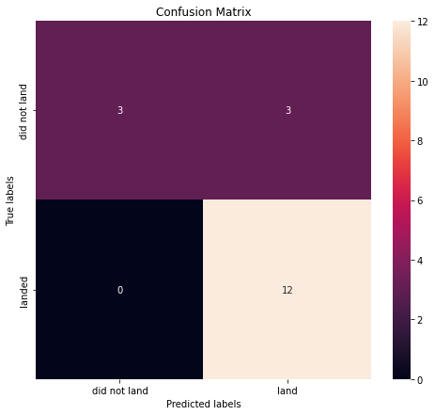
Confusion Matrix
Performance Summary :
• A confusion matrix summarizes the performance of a classification algorithm
• All the confusion matrices were identical
• The fact that there are false positives (Type 1 error) is not good
• Confusion Matrix Outputs:
• 12 True positive
• 3 True negative
• 3 False positive
• 0 False Negative
• Precision = TP / (TP + FP)
• 12 / 15 = .80
• Recall = TP / (TP + FN)
• 12 / 12 = 1
• F1 Score = 2 * (Precision * Recall) / (Precision + Recall)
• 2 * (.8 * 1) / (.8 + 1) = .89
• Accuracy = (TP + TN) / (TP + TN + FP + FN) = .833

Slide 45
Conclusions
Research :
• Model Performance: The models performed similarly on the test set with the decision tree model slightly outperforms
• Equator: Most of the launch sites are near the equator for an additional Natural boost – due to the rotational speed of the earth - which helps save the cost of putting in extra fuel and boosters
• Coast: All the launch sites are close to the coast
• Launch Success: Increases over time
• KSC LC-39A: Has the highest success rate among launch sites. Has a 100% success rate for launches less than 5,500 kg
• Orbits: ES-L1, GEO, HEO, and SSO have a 100% success rate
• Payload Mass: Across all launch sites, the higher the payload mass (kg), the higher the success rate
Things to Consider:
• Dataset: A larger dataset will help build on the predictive analytics results to help understand if the findings can be generalizable to a larger data set
• Feature Analysis / PCA: Additional feature analysis or principal component analysis should be conducted to see if it can help improve accuracy
• XGBoost: Is a powerful model which was not utilized in this study. It would be interesting to see if it outperforms the other classification models

Slide 46
References
IBM. Data Science Professional Certificate. https://www.coursera.org/professional-certificates/ibm-data-science
Source Code: https://github.com/Subrat-Nanda/IBM-Data-Science-Professional-Certification/DataScienceCapstoneProject

Slide 47
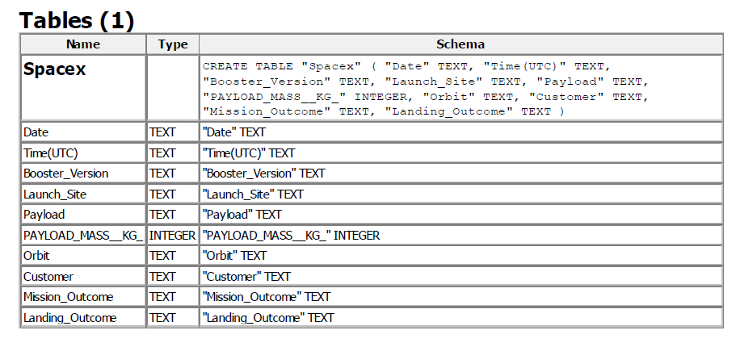
Appendix
SQLite Data Set
The table structure belongs to the SQLite data set used for SQL queries.

Slide 48

Thank you!

